Slide 1
ISBT 128 Implementation
Changes to Blood Component Labels
Spring 2009
Val Paulson, Hospital Liaison Specialist Prairie Region

Slide 2
What is ISBT 128?
“An international standard for the transfer of information associated with tissue transplantation, cellular therapy and blood transfusion.
It provides for a globally unique donation numbering system, internationally standardized product definitions and standard data structures for bar coding and electronic data interchange.”

Slide 3
International Standard
  Global standard introduced in 1994
  28 countries either implemented or planning implementation
Denmark
Estonia
Finland
Iceland
Kuwait
Netherlands
Norway
Singapore
Sweden
Switzerland
Austria
Belgium
Canada (Héma-Québec)
China
Egypt
Portugal
Turkey
United States
United Kingdom
Australia
Brazil
Canada (Canadian Blood Services)
Germany
Israel
Japan
Poland
Serbia
South Korea
Spain
Notes:
Blood agencies world wide are moving to the ISBT 128 standard.

Slide 4
ISBT 128 Technology Standard
Much more than a new label layout
Provides standard information and layout for blood component labels
Defines data structure for information appearing on labels
Defines data identifiers for bar codes used in blood component labelling & data transfer
Defines technical details for the bar code
More information about ISBT 128 labelling is available on ICCBBA website (iccbba.org)

Slide 5

ISBT 128 Donation Number
13 digit unique Donation Number plus flag & manual check characters = 16 characters
  Facility identification code (global)
  Year indicator (won’t repeat for 100 years)
  Sequential number (999,999/facility/year)
Additional elements – not part of unique DN (3 Digit)
  Flag characters
  Manual entry check character (Eye readable only)
All 16 characters must be recorded when transcribing the donation number.

Slide 6
Donation Number – Flag Characters
Flag Characters are the “sideways” numbers that are part of the manufacturing control processes
The flag characters will not be the same on the label ie. small Donation Number label = 20 and End label Donation Number = 21 or 22
Packing Slip CBS Crossmatch lab = 20
Packing Slip CBS Blood Product Distribtution = 00

Slide 7
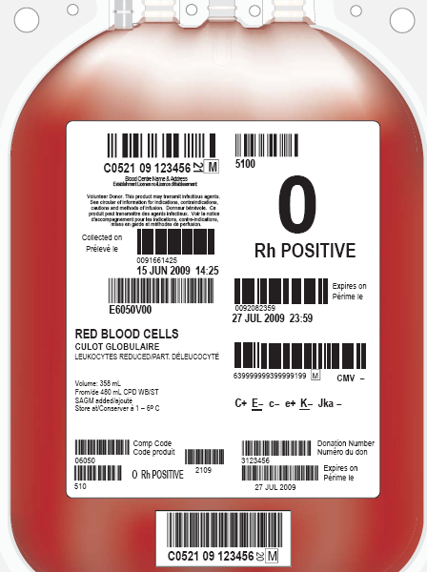
ISBT 128 Label
Product ABO/Rh
(ABO only
for plasma and cryopreciptate)
Product Code
Expiry Date
(Shelf life)
Product Type includes Irradiated
Special Testing ie Anti CMV
Volume
Ignore This Section (Extended Label)
Donation Number
IMPORTANT all 16 characters must be recorded C05210912345620M
Donation/Pool Number Label
Notes:
The placement of information on the label is generally the same globally.

Slide 8
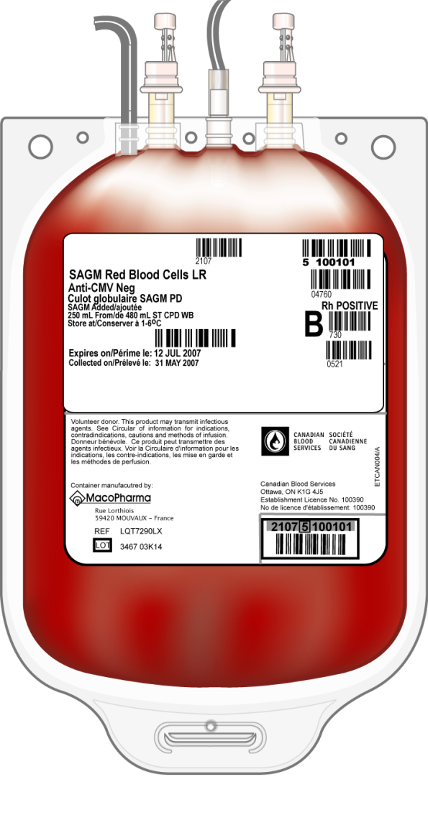
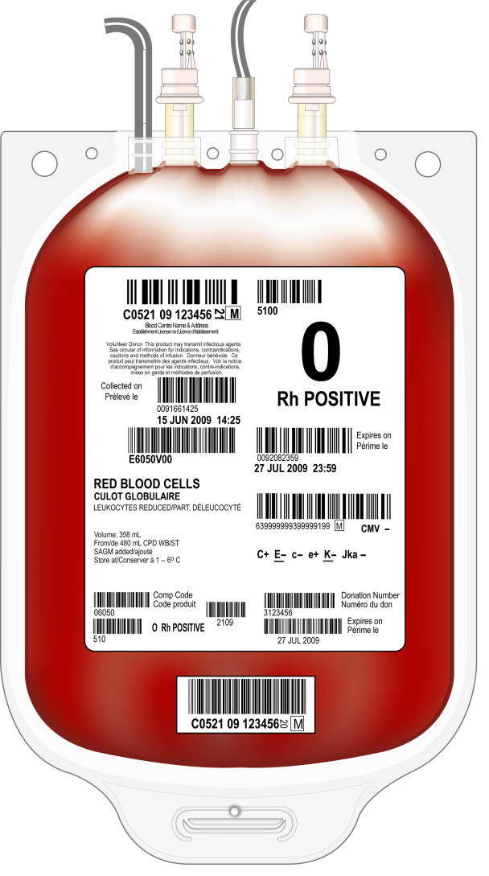
End Labelling – Before and After
Current
ISBT 128

Slide 9
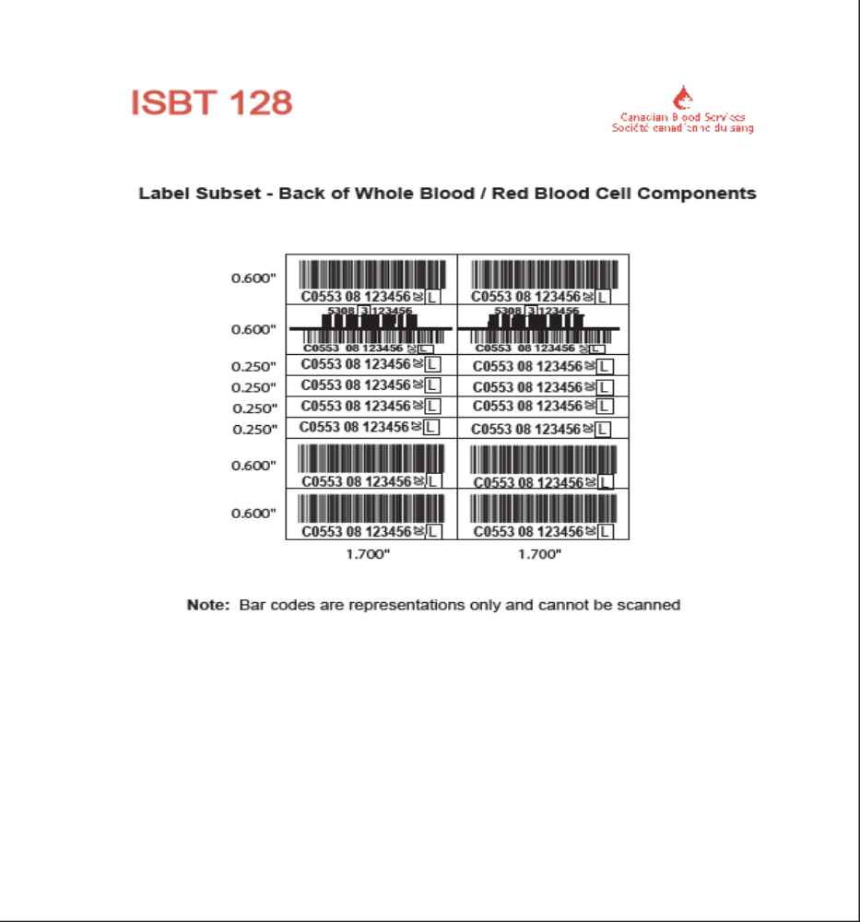

Slide 10
What Blood Product Labels Will Be Changing?
Red cells
Platelets
Plasma Products
Cryoprecipitate

Slide 11
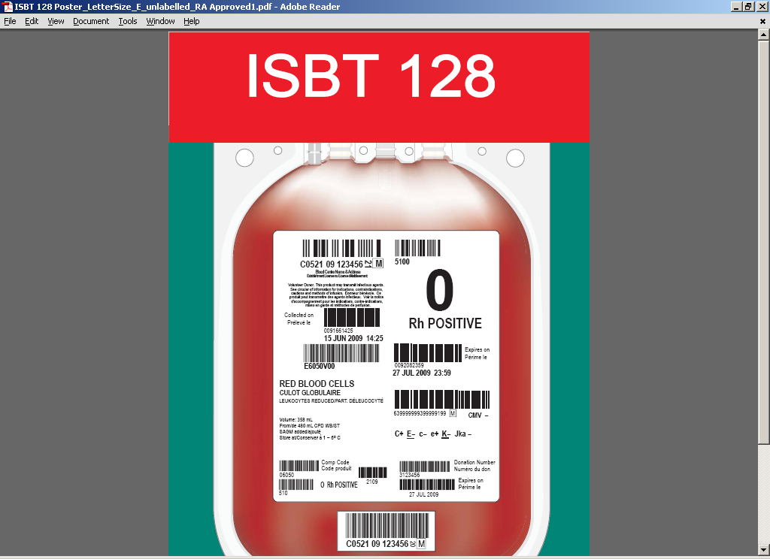
What Will Change?
Donation Number
Located on the small label in the middle at the bottom of the unit.
All 16 characters
Starts with letter C followed by 12 numbers
Two sideways numbers are Flag Characters.
Check character is in square box may be a number/letter/*/
CBS Crossmatch laboratory will document the full 16 characters for the Donation Number ie. C05210912345620M on x-m tags and the packing slip.
NOTE:
Hospital forms may need
to be revised to accommodate
the longer Donation Number

Slide 12
What Will Change?
PACKING SLIP
Product Codes on the CBS Blood Product Management Packing Slip will be the ISBT Product Code
Product Codes on the CBS Crossmatch Packing Slip will be the Product Code from Extended Label
Packing Slip layouts are different

Slide 13
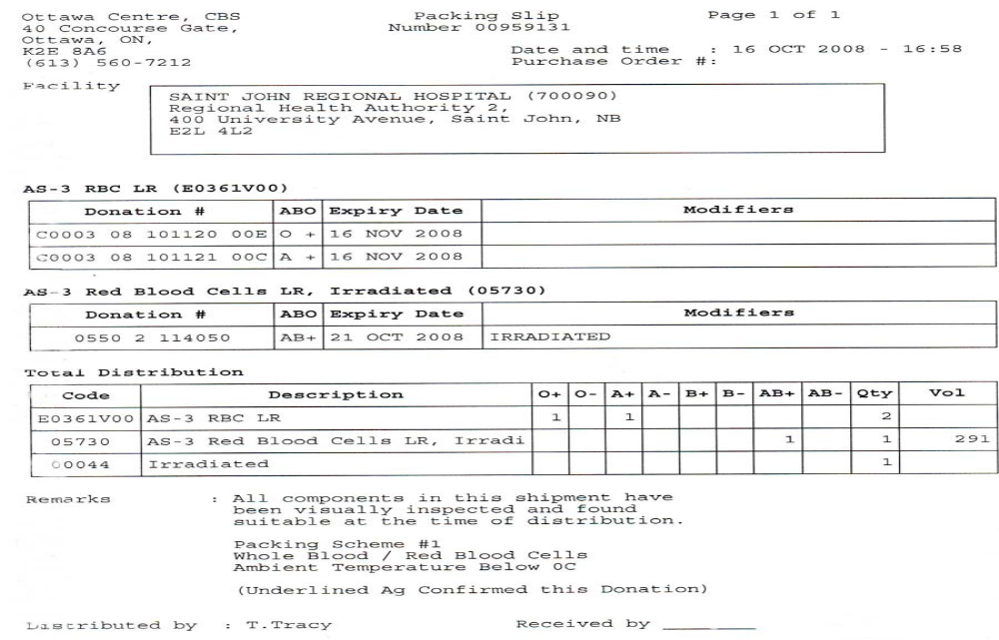
BPM Packing Slip

Slide 14
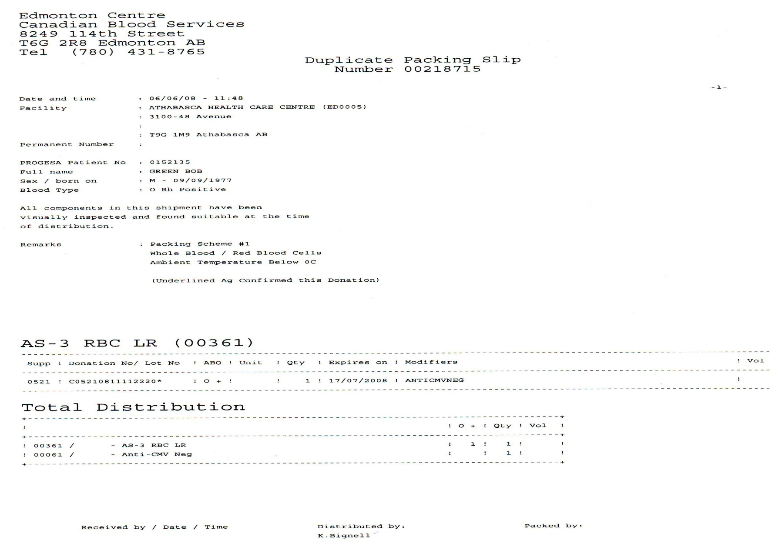
CBS Crossmatch Lab

Slide 15
When Will It Happen?
All Canadian Blood Services sites plan to implement new labels June 1, 2009.
Hospital forms may need to be revised to accommodate the longer Donation Number.
Previously labeled units will not be over labeled with new labels
Mixed Inventory - both labels will be seen for several weeks / months/ years
Extended section of label will be used for several months (some hospital LIS systems require this)

Slide 16
What Should I Remember ?
Do Not abbreviate the 16 digit Donation Number
Accurate transcription is imperative for traceability.
Correct verification of blood component Donation Number Label and patient identification is a Critical Component of Transfusion Safety

Slide 17
Further Information
All Canadian Blood Services Customer Letters
are available on www.blood.ca Hospital
Section
ISBT 128 Customer letters:
Customer Letter 2009-08
Customer Letter 2008-28
Customer Letter 2008-06

Slide 18
MB ISBT 128 Working Group
Created to assist hospitals with ISBT 128 implementation and to provide a coordinated approach for distribution of education tools to hospitals
Representatives from DSM, MB PBPCO, WRHA Nursing Office and CBS
Revised CBS education tools to meet MB hospitals needs ie. PPP presentations, one pagers and posters

Slide 19
For more information on ISBT 128 implementation at Canadian Blood Services: www.transfusionmedicine.ca

